Slide 1

Writing a .NET AddIn for Inventor
Presenter
Developer Technical Services

Slide 2
Agenda
.Net overview
Why create an addin
Registry add-in
Registry-Free add-in
Debugging
Automation
Lab: Creating an “Hello World” addin

Slide 3
.NET Overview
What is .NET?
.NET Framework
Common Language Runtime (CLR)
Object-Oriented programming environment
Common execution environment for .NET applications
Similar to Java VM with stronger interoperability
Framework Class Library (FCL)
Object Oriented Collection of re-usable types
(Source: MSDN)

Slide 4
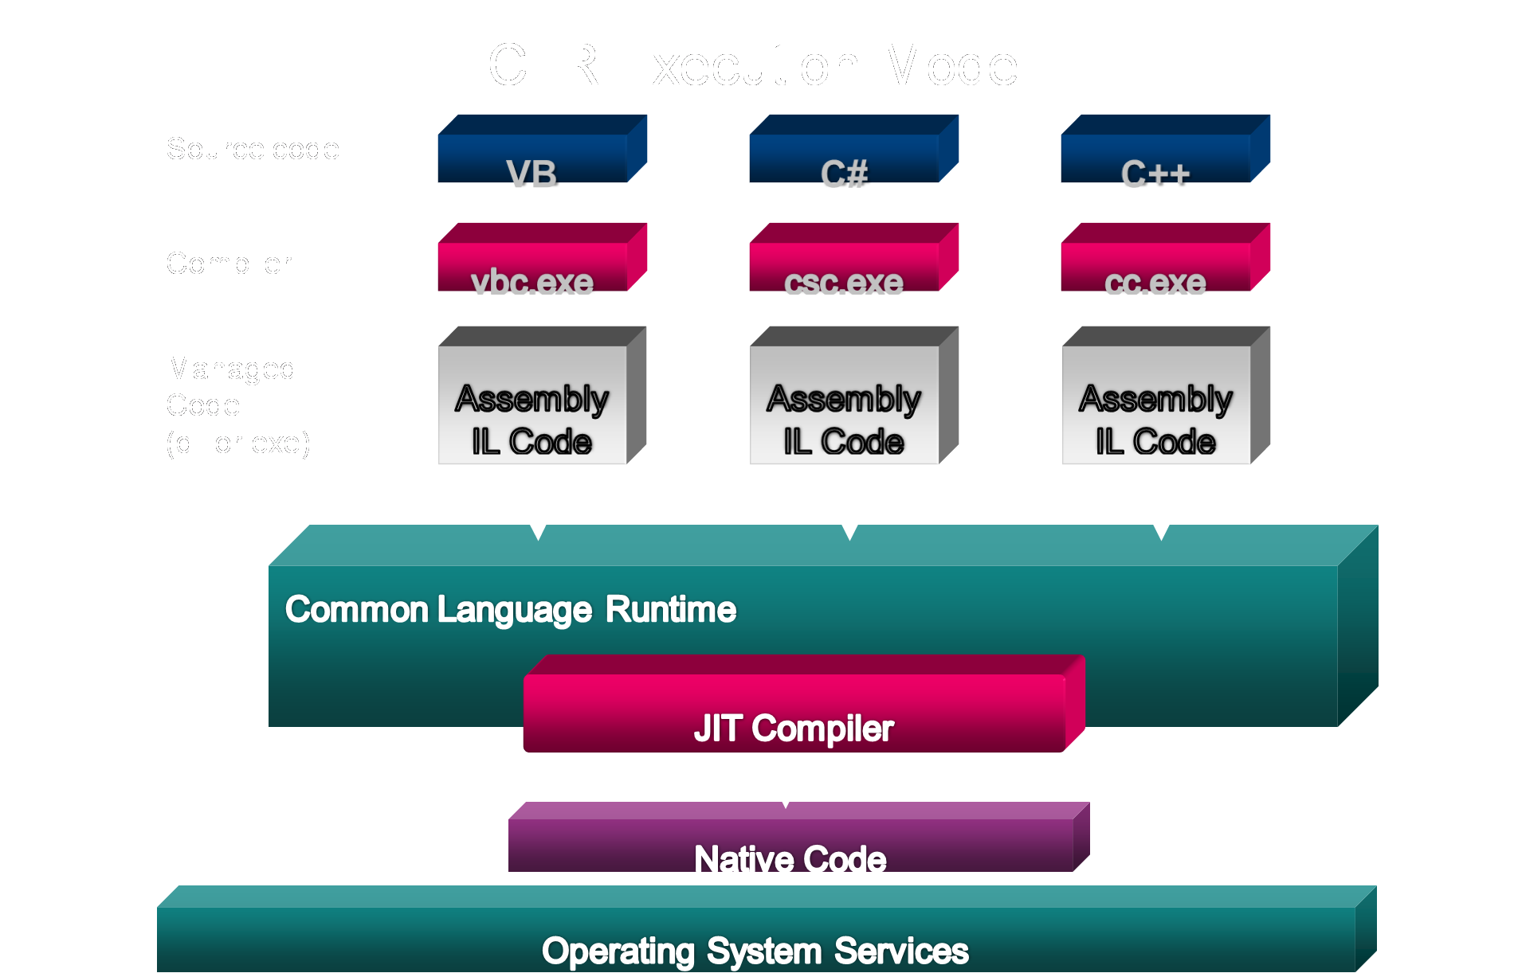
.NET Overview
Notes:
The diagram above illustrates the process used to compile and execute managed code, that is, code that uses the CLR.
Source code written in C#, VB.NET, or some other language that targets the CLR is first transformed into MSIL by the appropriate language compiler. [show with reflector]
Before execution, this MSIL is JIT compiled into native code for whatever processor the code will run on.
The default is to JIT compile each method when it is first called, but it’s also possible to “pre-JIT” the MSIL. With this option, all methods are compiled before the application is loaded, so the overhead of JIT compilation on each initial method call is avoided.
One point worth noting is that all languages targeting the CLR should exhibit roughly the same performance. While some compilers may produce better MSIL code than others, large variations in execution speed are unlikely.

Slide 5
What is an Add-In?
COM Component
Registered or Registry-Free as an Inventor Add-In
Started by Inventor during start-up
Passed the Inventor Application object at start-up
Notes:
- It’s a COM component. You can use various programming environments and languages to create it
A COM component needs to be registered in the registry in order to be used. In case of an Inventor COM component the registration needs to have some extra properties so that Inventor can see that this is an AddIn
When Inventor starts it checks the COM components and their properties. If the appropriate properties is added to the COM component’s registration, Inventor will load the component and will call its Activate function where the AddIn can create the framework of its functionality – so it can create the buttons or other User interface elements for the user, and can also apply for various Inventor events.
For
In the Activate function of the AddIn the Inventor Application is passed in, though which all the Inventor functionality is available for the AddIn

Slide 6
Why Create an Add-In?
Advantages of an Add-In
Loads on startup
Can use new languages
Can fully integrate into Inventor’s user-interface
Better at handling events
Installation
Easier to manage the source code
Code Security
Better support for transactions and transcripting
Notes:
Some of the advantages of the AddIns were mentioned on the previous slide, like that it is loaded during start-up.
you can also use a wide variety of languages, like VB, C++, the .NET languages including C++.NET or F#, or even Delphi.
you can create any sort of user interface elements
it’s better at handling events
you can create an installer for it
your source code is more protected, not only from reverse engineering but accidental modifications
better support for transactions and transcripting

Slide 7
Why Create an Add-In?
Advantages of VBA
Easier to write
Better for rapid prototyping
Better object browser
Debugger is better at looking at Inventor objects
Notes:
easier to write, because the environment is always there, you just press ALT+F11, and you can start coding
this is also why it means quicker development
the object browser is better
which is also very useful during debugging

Slide 8
Registry addin
Old style before Inventor 2012
COM Registration section
Register with Inventor
Inventor checks all available addins and loads them
Still supported in Inventor 2012,2013 for compatible
Tutorial:
http://download.autodesk.com/media/adn/Autodesk_Inventor_API_Module8_AddIns_22April10.zip
Notes:
When Inventor starts it checks the COM components and their properties. If the appropriate properties is added to the COM component’s registration, Inventor will load the component and will call its Activate function where the AddIn can create the framework of its functionality

Slide 9
Registry-Free Add-Ins
Registration-free COM is a mechanism available on the Microsoft Windows XP SP2 onwards
Since the 2012 release, registry-free COM add-ins are supported by Inventor
Using registry-free COM add-ins is the recommended approach
The add-in wizard will create registry free add-ins
Notes:
Registration-free COM is a mechanism available on the Microsoft Windows XP (SP2 for .NET-based components) and Later Microsoft operating systems. As the name suggests, the mechanism enables easy (for example, using XCOPY) deployment of COM components to a machine without the need to register them.
On the target platforms, one of the stages of initializing a process and its dependent modules is to load any associated manifest files into a memory structure called an activation context. In the absence of corresponding registry entries, it is an activation context that provides the binding and activation information the COM run time needs. No special code is required in the COM server or in the client unless you choose to obviate the use of files by building activation contexts yourself using the activation context API.
Registry-Free COM Registration
With Reg-Free COM, COM data is written to an application manifest file that is stored in the application folder. The manifest file is an XML file that contains information about an application and the libraries that are associated with it. Note that the Reg-Free COM manifest file, the executable file, and the COM libraries should all be installed to the same folder on the target machine.
Benefits of Reg-Free COM
Reg-Free COM has several advantages over traditional COM. For example, with Reg-Free COM, the component is defined within the scope of the application itself. Even if other applications that use the same COM component or a different version of it require that it be registered, it will not interfere with this application.
Problems may occur with traditional COM registration if multiple versions of shared libraries exist on a target system. For example, an installation may overwrite a new version of a shared library with an older version, or a new version might not be backwardly compatible with older versions. This may cause applications that require features of a specific version to crash. These types of situations are commonly known as DLL Hell. With Reg-Free COM, you can avoid these problems because other applications cannot access your application’s COM component.
In addition, Reg-Free COM streamlines the upgrade and uninstallation processes. For an upgrade, simply replace the application folder. For an uninstallation, simply remove that folder.
Limitations of Reg-Free COM
Reg-Free COM is not appropriate for some solutions. Several limitations exist:
Reg-Free COM works on only Windows XP or later.
A component is not suitable for Reg-Free COM if it is a system component or part of the operating system. In addition, it is not suitable if it is a data access component such as Microsoft Data Access Components (MDAC). These types of components should not be isolated. Some of these components, such as MDAC, can be included in an installation as a redistributable.
A COM component can be isolated only once per application. Consider grouping COM components in a single class library as a workaround to this limitation.

Slide 10
Registry Free Add-in components
A .addin file defines the various settings that used to be defined in the registry
.addin file placed in a certain directory monitored by Inventor at start up and references add-in dll. Add-in dll can be placed anywhere.
A manifest file needs to be embedded into the add-in dll

Slide 11
Example .addin file
<Addin Type="Standard">
<ClassId>{9c93ff52-e2fa-4ec4-8c4a-5747ad0bafef}</ClassId>
<ClientId>{9c93ff52-e2fa-4ec4-8c4a-5747ad0bafef}</ClientId>
<DisplayName>Attribute Helper</DisplayName>
<Description>Utility to manage API attributes.</Description>
<Assembly>AttributeHelper.dll</Assembly>
<LoadOnStartUp>1</LoadOnStartUp>
<UserUnloadable>1</UserUnloadable>
<OSType>Win64</OSType>
<Hidden>0</Hidden>
<SupportedSoftwareVersionGreaterThan>
15..
</SupportedSoftwareVersionGreaterThan>
<DataVersion>1</DataVersion>
<UserInterfaceVersion>1</UserInterfaceVersion>
</Addin>
Notes:
The path to the add-in dll is either a full path “C:\MyStuff\AttributeHelper.dll” or it can be a relative path that is relative to the .addin file.
The OSType is a new capability this release that lets you specify if your add-in should be loaded for 32 or 64-bit OS. If not specified, it will load for both.

Slide 12
.addin Localization (Support in 2013)
<Addin Type="Standard">
<ClassId>{9c93ff52-e2fa-4ec4-8c4a-5747ad0bafef}</ClassId>
<ClientId>{9c93ff52-e2fa-4ec4-8c4a-5747ad0bafef}</ClientId>
<DisplayName Language="1033">Attribute Helper</DisplayName>
<Description Language="1033">
Utility to manage API attributes.
</Description>
<DisplayName Language="1036">Attribute Helper</DisplayName>
<Description Language="1036">
Utilitaire pour gérer les attributs d'API.
</Description>
...
</Addin>
Notes:
The display name and description information of an add-in can now be localized.
Windows Locale Codes

Slide 13
Sample of Manifest File (.NET)
<?xml version="1.0" encoding="UTF-8" standalone="yes"?>
<assembly xmlns="urn:schemas-microsoft-com:asm.v1" manifestVersion="1.0">
<assemblyIdentity name="VBNetFreeRegSample“
version="1.0.0.0">
</assemblyIdentity>
<clrClass clsid="{d8554e7b-9d1a-48e7-850b-137951bdcfd0}"
progid=“VBNetFreeRegSample.StandardAddInServer"
threadingModel="Both"
name="VBNetFreeRegSample.StandardAddInServer"
runtimeVersion=""></clrClass>
<file name="VBNetFreeRegSample.dll" hashalg="SHA1"></file>
</assembly>

Slide 14
Sample of Manifest File (C++)
<?xml version="1.0" encoding="utf-8" standalone="yes"?>
<assembly xmlns="urn:schemas-microsoft-com:asm.v1" manifestVersion="1.0">
<assemblyIdentity type="win32" name="CPPFreeRegSample" version="1.0.0.0" />
<file name=“CPPFreeRegSample.dll">
<comClass clsid="{5742E624-7617-4414-9F9F-87A43339F9EB}" />
<typelib tlbid="{4B1EAE87-CA6D-4D4A-88D9-53F02E786E66}" version="1.0" helpdir=""/>
</file>
</assembly>

Slide 15
.addin File Locations
Version Independent
Windows7/Vista:
%ALLUSERSPROFILE%\Autodesk\Inventor Addins\
Windows XP:
%ALLUSERSPROFILE%\Application Data\Autodesk\Inventor Addins\
Version Dependent
Windows7/Vista:
%ALLUSERSPROFILE%\Autodesk\Inventor 2012\Addins\
Windows XP:
%ALLUSERSPROFILE%\Application Data\Autodesk\Inventor 2012\Addins\
Per User Override
Windows7/Vista & XP:
%APPDATA%\Autodesk\Inventor 2012\Addins\
App Store
Windows7/Vista & XP:
%APPDATA%\Autodesk\ApplicationPlugins

Slide 16
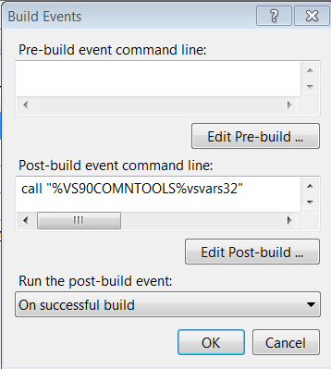
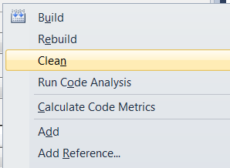
Template post build and clean steps ( .NET)
Post-Build:
:
call "%VS90COMNTOOLS%vsvars32" mt.exe -manifest
"$(ProjectDir)projectname.X.manifest" -outputresource:"$(TargetPath)";#2
xcopy /y "$(ProjectDir)Autodesk.projectname.Inventor.addin"
"$(AppData)\Autodesk\Inventor 2012\Addins\"
AfterClean: (manual editing of .vbproj / .vcproj file)
<Target Name="AfterClean">
<Delete Files="$(AppData)\Autodesk\Inventor
2012\Addins\Autodesk.projectname.Inventor.addin" />
</Target>

Slide 17
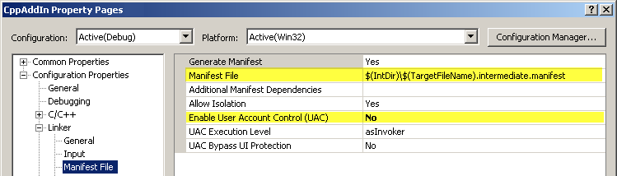
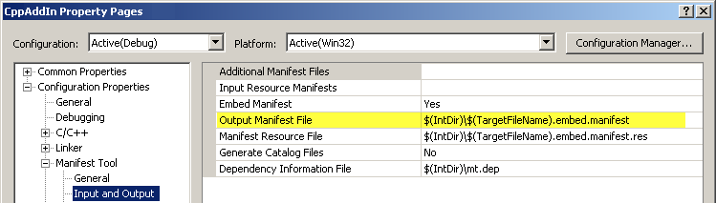
Template post build (C++)
Setting in Linker
Make sure “Embed Manifest” is “Yes”

Slide 18
Visual Studio Express limitations
Visual Studio Express Edition has a few limitations:
Post-Build step not available > Perform manually or use .bat file
AfterClean step not available
New project created on TEMP folder > Call ‘Save All’, select folder and change .addin and post-build accordingly

Slide 19
Registry Free COM - Further reading
For advanced information about registry-free COM components refer to MSDN website:
http://msdn.microsoft.com/en-us/library/ms973913.aspx
http://msdn.microsoft.com/en-us/library/ms973915.aspx#rfanetwalk_topic9

Slide 20
Creating an Add-In

Slide 21
How Do You Create an Add-In?
What do I use to create an Add-In?
Visual Basic 2010 (Ultimate/Professional)
Full features support
Visual Basic 2010 Express Edition
Free
Good, free online documentation for non-programmers
Simplified user-interface (compared to Visual Studio)
Has some limitations
No 64 bit support
No installer support
No Visual Studio Add-In support
No ASP.Net development
No Pocket PC development
Notes:
There is also an Express edition of this environment, which is free, has free online documentation, simplified user interface, but obviously with no money to pay for it, the feature are restricted:
no 64 bit support, no installer support, you cannot enhance the feature of Visual studiio here, no ASP development or pocket pc development [the last two items are not really relevant from our point of view]

Slide 22
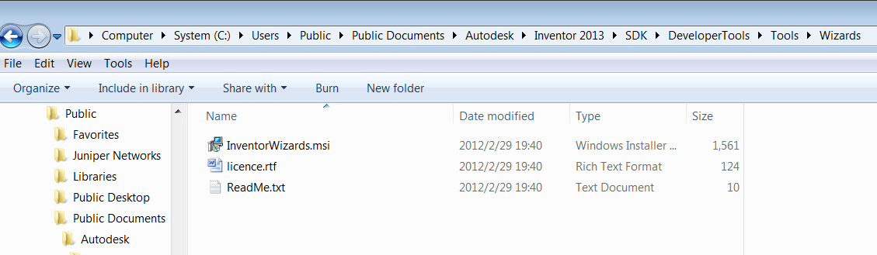
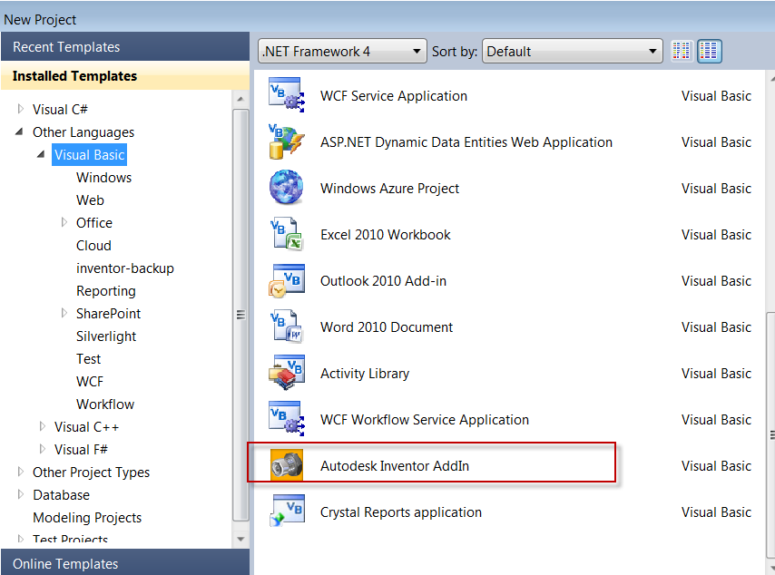
How Do You Create an Add-In?
Inventor Add-In Wizard
Install from SDK\DevelopersTools\Tools\Wizards directory
Use “Autodesk Inventor AddIn” template for new Add-In.
Notes:
We provide a nice helper called Inventor AddIn wizard. Since the popularity of .NET is growing among developers, therefore what this wizard provides is a .NET (both C# and VB.NET) template.
This is actually a template project, which has all the settings and code to make a functioning Inventor .NET AddIn.
So once you create such a project, you can already compile it, load it into Inventor and if you placed a break point in the Activate function of this AddIn you can see that Inventor calls it.
1. Install the wizard
- Make sure you run Visual Studio first
- run "C:\Program Files\Autodesk\Inventor 2013\SDK\DeveloperTools.msi"
- run "C:\Program Files\Autodesk\Inventor 2013\SDK\DeveloperTools\Tools\Wizards\InventorWizards.msi“
In case of Vista, the SDK will be installed to the Users folder, for it is a more restrictive operating system.
“C:\Users\Public\Documents\Autodesk\Inventor 2013\SDK”
BTW tutorial files are at:
“C:\Users\Adam\AppData\Local\Autodesk\Inventor 2013\Tutorial Files
2. Create AddIn
- Create "InventorAddIn1" using the Wizard project
- Click "Show All" button
- In 2010 you needed to create your own interop assembly strong-named

Slide 23
Inventor SDK addin wizard
Inventor addin wizard（2012 and above）can produce registry-free addin
\SDK\DeveloperTools\Tools\Wizards\InventorWizards.msi
Problems:
C++ ：The final dll has prefix string of RDS while manifest file has not. So make sure to keep them consistent
VB.NET 和 C#：
Post-build event does not copy the *.addin file to the specific folder.
No clean event

Slide 24
Manually Installing the Add-In Template
Allow to support VB Express 2010 with Inventor 2013
Get the template files (provided with this course)
- VBInventorAddInTemplate.zip.
- VCSInventorAddInTemplate.zip.
Copy the zip files to the following location, Don't unzip them but just copy the files as-is.
"My Documents\Visual Studio 2010\Templates\ProjectTemplates"
Notes:
Included with the Inventor SDK is a template used to create Add-Ins using VB and C#. At the time Inventor 2009 was released VB 2005 Express Edition was the current release, so installing the template does not install it for VB 2008 Express. You can easily work around this issue using the steps below.
Normally you just run the InventorWizards.msi file from the directory shown below to install the template but the workaround above is to support VB 2008 Express with Inventor 2009.

Slide 25
Interop Assembly
Inventor 2008 and before
Interop assembly is automatically created when the COM library is referenced
Can create interop assembly manually as well:
tlbimp rxinventor.tlb /out:c:\MyAddIn\myversionof.interop.inventor.dll /primary [/keyfile:c:\MyAddIn\mykey.snk /namespace:Inventor]
Inventor 2009 and later
A strong named interop assembly is part of the install and placed in the GAC (Global Assembly Cache)
On X64, VS may not list it in [Add Reference] dialog. Can add it from <Inventor 2013 Install Path>\Bin\ Public Assemblies\ Autodesk.Inventor.Interop.dll
Notes:
Interop assembly is needed to interact from .NET with the Inventor COM library.
In case of Inventor 2008 and previous releases you needed to reference the COM library in your .NET project and Visual Studio created the interop assembly for you.
You could also create the interop assembly manually or in case you needed to create a string named AddIn, then the interop assembly needed to be string named as well, and therefore you had to create the interop assembly yourself providing a strong neme key.
In case of Inventor 2009 the strong named interop assembly is part of the Inventor installation and is placed in the GAC, you can just reference it as any other Microsoft .NET assemblies.
If you want to make your AddIn compatible with 2008 and 2009 as well (and is not dependent on any Inventor 2009 specific feature), then you would need to reuse the assembly created for your Inventor 2008 AddIn.
Using .Net with Inventor's API
From Inventor 2009, a Primary Interop Assembly (PIA) is supplied. This provides the .Net compatible interface to Inventor's API. The .Net languages require a .Net compatible programming interface but Inventor's API is a COM Automation interface. An Interop assembly provides a .Net compatible interface to a COM Automation API. In all previous versions of Inventor you had to create your own interop assembly. Visual Studio does this automatically whenever you reference a COM type library. The fact that every .Net program had its own interop assembly resulted in additional memory being consumed, and because of the way .Net resolves these assemblies, unexpected behavior could have also resulted in some cases.
A primary interop is one created by Autodesk and delivered for all clients to use. The PIA is delivered into the Global Assembly Cache (GAC) where everyone has access to it. All clients that are writing code using any of the .Net languages should now use this primary interop assembly.
Although the PIA is delivered into the GAC when Inventor is installed, it is only usable by existing applications. .Net does not allow you to directly reference the PIA that is in the GAC but requires you to select a PIA outside of the GAC. This will still result in using the PIA in the GAC. The external version of Inventor's PIA is delivered as part of the new Developer Tools install in the SDK. Once you've installed the DeveloperTools.msi you'll see "Autodesk.Inventor.Interop" in the .Net tab of the "Add Reference" dialog within Visual Studio.
There are some differences between the PIA and the interop assembly automatically generated when referencing the Inventor type library. The difference provides for more correct type information in the PIA. The primary change is that instead of arrays being declared as generic System.Array types, they are now type specific, i.e. Double(). This change will require edits to your code, but they're easily corrected, and appropriate messages will appear at compile time.

Slide 26
Add-In Basics
Activate
Deactivate
Registration (for registry addin)
ClientID
m_inventorApplication = addInSiteObject.Application
Marshal.FinalReleaseComObject(m_inventorApplication)
m_inventorApplication = Nothing
GC.WaitForPendingFinalizers()
GC.Collect()
subKey.SetValue("SupportedSoftwareVersionGreaterThan", "11..")
GuidAttribute("f61ba061-ae85-47a2-a344-b96f761401ea")
Notes:
So these are the main parts of this framework provided by the template:
The Activate function, where you can get the Inventor Application object and set up the user interface and event handling you need
the Deactivate function, where you can free all the resources used by your AddIn. Here we explicitly detach from any COM object that we were using globally inside our AddIn class, and then ask the garbage collector to free those objects. IF we did not do it, then .NET may hold onto some of the Inventor objects which would result in Inventor not being able to close properly.
ClientID, which is a GUID, i.e. your AddIn’s unique identifier
Registration part, where all the additional necessary information is placed in the registry which will make Inventor find your AddIn
show all parts in the AddIn

Slide 27
Versioning
Version <> Registered Version
FirstTime = True
Create ControlDefinitions and CommandCategories. Create the Environments, CommandBars, and Controls, as required
Version = Registered Version
FirstTime = False
Current controls, command bars and environments are kept as and where they are
Create ControlDefinitions and CommandCategories
Notes:
By default once an AddIn created its user interface, then Inventor will take care of it – store it’s position, the environments it’s in and re-associate them to the appropriate component definition when the AddIn gets loaded.
That is if the version number remains the same. But you may create a new version, which would have different user interface (or at least something would be different).
IN this case you just change the version number and Inventor takes care of the rest

Slide 28
Debugging from VB Express
Create file MyAddIn.vbproj.user:
<Project xmlns="http://schemas.microsoft.com/developer/msbuild/2003">
<PropertyGroup Condition=" '$(Configuration)|$(Platform)' == 'Debug|AnyCPU' ">
<StartAction>Program</StartAction>
<StartProgram>C:\Program Files\Autodesk\Inventor 2013\Bin\Inventor.exe</StartProgram>
</PropertyGroup>
<PropertyGroup>
<ProjectView>ShowAllFiles</ProjectView>
</PropertyGroup>
</Project>
Notes:
For my sample project, VB.Net created the file MyAddIn.vbproj as the project file. To be able to debug this Add-In, You need to create the file MyAddIn.vbproj.user.
The new file has the same name as the project file with the addition of the “.user” extension. The contents of this file are the same regardless of the name of the project.
You need to restart MSVS in order to be able to launch addin in debug mode

Slide 29
Registry Free Add-in Migration

Slide 30
Step 1 - Removing COM visibility (.Net)
Remove code associated with registering the add-in in the registry: This means removing the Register and Unregister methods from your add-in class
The AddInGuid property is in the same region as the registration functions, so if you intend on using this property in other areas of your add-in you’ll want to be careful not to delete it
Uncheck the Register for COM interop check box on the “Compile” tab of the Application Properties dialog

Slide 31
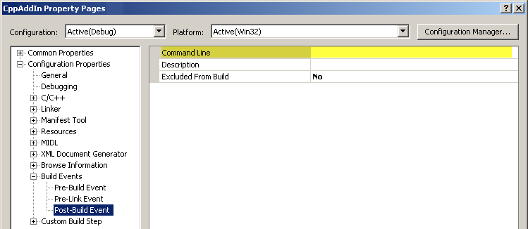
Step 1 - Removing COM visibility (C++)
Remove code associated with registering the add-in in the registry: remove the .rgs file associated with the project, delete DllRegisterServer and DllUnregisterServer functions.
Uncheck the Register for COM interop check box on the "Build" tab of the Application Properties dialog.
Finally remove post-build step that registers the add-in found in the Build Events section of the settings: Clear out any text in the Command Line field:

Slide 32
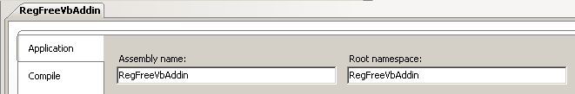
Step 2 - Creating manifest file
Create a new file in the same directory as your project file and name it AddinName.X.manifest, where AddinName will be replaced with the name of your add-in (see next slide)
The “name” attribute of the clrClass element consists of three parts, separated by dots:
Assembly.Namespace.AddInServerClassName
To make sure, you can retrieve the assembly name and root namespace from your project properties:

Slide 33
Step 2 - Creating manifest file .NET dll
<?xml version="1.0" encoding="UTF-8" standalone="yes"?>
<assembly xmlns="urn:schemas-microsoft-com:asm.v1" manifestVersion="1.0">
<assemblyIdentity name="RegFreeVbAddin" version="1.0.0.0"></assemblyIdentity>
<clrClass clsid="{6e41e3fb-439a-4cbe-b648-ed6a47eeac8d}"
progid="RegFreeVbAddin.StandardAddInServer"
threadingModel="Both"
name="RegFreeVbAddin.RegFreeVbAddin.StandardAddInServer"
runtimeVersion="1.0">
</clrClass>
<file name="RegFreeVbAddin.dll" hashalg="SHA1"></file>
</assembly>

Slide 34
Step 2 - Creating manifest file C++ dll
<?xml version="1.0" encoding="utf-8" standalone="yes"?>
<assembly xmlns="urn:schemas-microsoft-com:asm.v1" manifestVersion="1.0">
<assemblyIdentity type="win32" name="CPPFreeRegSample" version="1.0.0.0" />
<file name=“CPPFreeRegSample.dll">
<comClass clsid="{5742E624-7617-4414-9F9F-87A43339F9EB}" />
<typelib tlbid="{4B1EAE87-CA6D-4D4A-88D9-53F02E786E66}" version="1.0" helpdir=""/>
</file>
</assembly>

Slide 35
Step 3 - Creating .addin file
<Addin Type="Standard">
<ClassId>{6e41e3fb-439a-4cbe-b648-ed6a47eeac8d}</ClassId>
<ClientId>{6e41e3fb-439a-4cbe-b648-ed6a47eeac8d}</ClientId>
<DisplayName>RegFreeVbAddin</DisplayName>
<Description>A Registry-free Inventor Addin</Description>
<Assembly>C:\Autodesk\Inventor\MyAddins\RegFreeVbAddin.dll</Assembly>
<LoadOnStartUp>1</LoadOnStartUp>
<UserUnloadable>1</UserUnloadable>
<Hidden>0</Hidden>
<SupportedSoftwareVersionGreaterThan>15..</SupportedSoftwareVersionGreaterThan>
<DataVersion>1</DataVersion>
<UserInterfaceVersion>1</UserInterfaceVersion>
<LoadBehavior>0</LoadBehavior>
</Addin>

Slide 36
Step 4 – Embedding Manifest (.Net)
Post-Build:
call "%VS90COMNTOOLS%vsvars32" mt.exe -manifest
"$(ProjectDir)$projectname$.X.manifest" -outputresource:"$(TargetPath)";#2
xcopy /y "$(ProjectDir)Autodesk.$projectname$.Inventor.addin"
"$(AppData)\Autodesk\Inventor 2013\Addins\"
AfterClean: (manual editing of .vbproj / .vcproj file)
<Target Name="AfterClean">
<Delete Files="$(AppData)\Autodesk\Inventor
2013\Addins\Autodesk.$projectname$.Inventor.addin" />
</Target>

Slide 37
Step 4 – Embedding Manifest (C++)
The first two settings are part of the Linker settings. The settings and the values to change them to are highlighted in the picture below.
The next setting is of the Manifest Tool settings. Make sure the "Embed Manifest setting is set to "Yes":

Slide 38
Step 5 - Copying .addin file
Version Independent
Windows7/Vista:
%ALLUSERSPROFILE%\Autodesk\Inventor Addins\
Windows XP:
%ALLUSERSPROFILE%\Application Data\Autodesk\Inventor Addins\
Version Dependent
Windows7/Vista:
%ALLUSERSPROFILE%\Autodesk\Inventor 2013\Addins\
Windows XP:
%ALLUSERSPROFILE%\Application Data\Autodesk\Inventor 2013\Addins\
Per User Override
Windows7/Vista & XP:
%APPDATA%\Autodesk\Inventor 2013\Addins\
App Store
Windows7/Vista & XP:
%APPDATA%\Autodesk\ApplicationPlugins

Slide 39
Registry Free add-in deployment

Slide 40
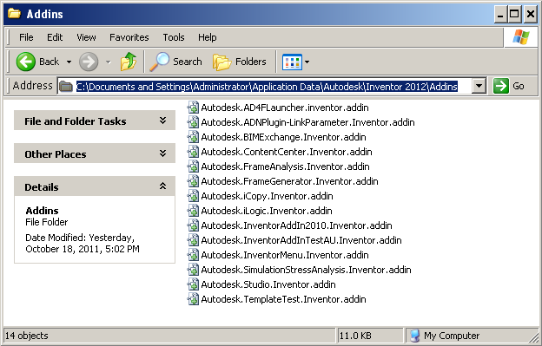
Add-in Installer – Registry Free
Inventor 2012 registry-free add-in mechanism
based on “.addin” copied at specific location
on the machine.
Add-in dll can be placed anywhere on the
directory structure
However how to handle this feature for the
programmer since we do not know in advance
where the user is going to install the add-in dll?
Notes:
Copy add-in dll file to one of following locations:
a) Anywhere, then *.addin file <Assembly> setting should be updated to the full path including the dll name
b) Inventor <InstallPath>\bin\ folder, then *.addin file <Assembly> setting should be the dll name only: <AddInName>.dll
c) Inventor <InstallPath>\bin\XX folder, then *.addin file <Assembly> setting shoule be a relative path: XX\<AddInName>.dll
Copy.addin manifest file to one of following locations:
a) Inventor Version Dependent
Windows XP:
C:\Documents and Settings\All Users\Application Data\Autodesk\Inventor 2012\Addins\
Windows7/Vista:
C:\ProgramData\Autodesk\Inventor 2012\Addins\
b) Inventor Version Independent
Windows XP:
C:\Documents and Settings\All Users\Application Data\Autodesk\Inventor Addins\
Windows7/Vista:
C:\ProgramData\Autodesk\Inventor Addins\
c) Per User Override
Windows XP:
C:\Documents and Settings\<user>\Application Data\Autodesk\Inventor 2012\Addins\
Windows7/Vista:
C:\Users\<user>\AppData\Roaming\Autodesk\Inventor 2012\Addins\

Slide 41
Add-in Installer – Registry Free
public string InstallRegistryFree(IDictionary stateSaver)
{
// Get addin dll location
Assembly Asm = Assembly.GetExecutingAssembly();
FileInfo asmFile = new FileInfo(Asm.Location);
FileInfo addinFile = null;
foreach (FileInfo fileInfo in asmFile.Directory.GetFiles())
if (fileInfo.Extension.ToLower() == ".addin")
{
addinFile = fileInfo;
break;
}
XmlDocument xmldoc = new XmlDocument();
xmldoc.Load(addinFile.FullName);
XmlNode node = xmldoc.GetElementsByTagName("Assembly")[0];
node.InnerText = asmFile.FullName;
xmldoc.Save(addinFilenameDest);
...
}

Slide 42
Add-in Installer – Registry Free
Registry free add-in installer class can easily be created using the custom template for C# and VB.Net in the material provided with that DevTV
To installing the custom templates Copy RegFree Installer Template C#.zip and RegFree Installer Template VB.Net.zip to the following location:
Windows XP:
C:\ Documents and Settings \<user>\My Documents\Visual Studio <version>\Templates\ItemTemplates
Windows Vista/7:
C:\Users\<user>\My Documents\Visual Studio <version>\Templates\ItemTemplates

Slide 43
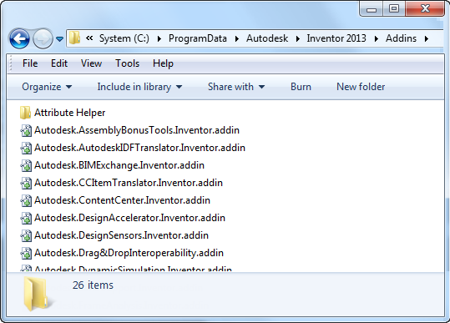
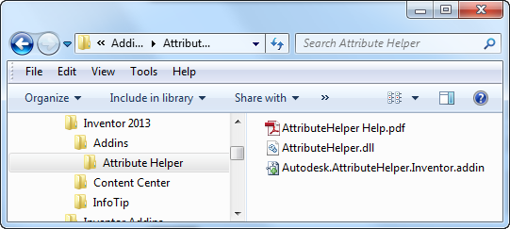
Inventor App Store Deployment (2013)
Add-in dll + resouces + .addin file placed in a folder
Folder must be drag and drop ready
Installer can copy folder to %APPDATA%\Autodesk\ApplicationPlugins
At Inventor start-up subdirectories will be searched for .addin files
Path to add-in dll is relative path to .addin location
Notes:
It’s now possible to have all of the files an add-in requires to be in a single directory and when copied into one of the valid add-in locations will enable your add-in. Subdirectories beneath the add-in location directories will be searched for .addin files. So a folder dropped into an add-in location can contain subfolders and can contain multiple .addin files that can specify to load different dll’s based on OS type and version.

Slide 44
Automation
Interaction with AddIn
External application
Another AddIn
VBA
Steps
Create interface
Make AddIn implement it
Return it as Automation property

Slide 45
Automation
Interface
Usage
Imports System.Runtime.InteropServices
Namespace MyAddIn
<GuidAttribute("dc87720d-8e8d-4575-b6e4-64cfa5ca13f8")> _
Public Interface MyInterface
Function MyFunction(ByVal someString As String) As String
End Interface
End Namespace
Sub CallMyInterface()
Dim invAddIn As ApplicationAddIn
Set invAddIn =
_InvApplication.ApplicationAddIns.ItemById("{dc87720d-8e8d-4575-b6e4-64cfa5ca13f7}")
MsgBox invAddIn.Automation.myFunction("some string")
End Sub

Slide 46
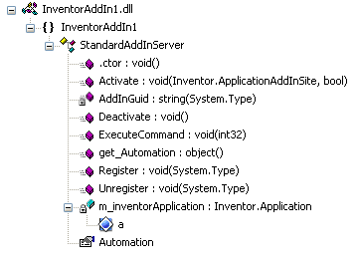
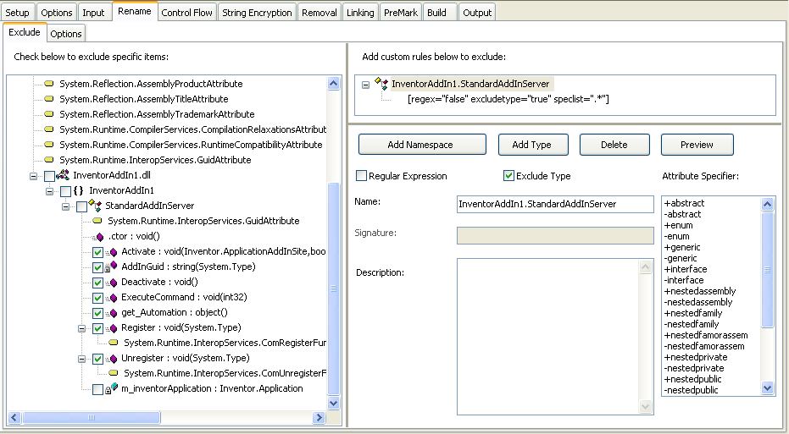
Dotfuscator
Notes:
Since .NET assemblies contain meta data (i.e. additional information about the functions, properties, and everything else), therefore using reflection you can get the whole content of the code – e.g using Reflector – and then can easily reuse it.
In “normal” dlls, which are compiled to machine code you cannot find information like this, and therefore it is much harder to reverse engineer what it is doing.
What you can do to make your code safer is to make it less readable, for which you can use Dotfuscator. What it does is simply renaming it’s functions, properties, etc. so when someone looks at it, it’s harder to follow the logic, which function or property does what.
If you decide to use this tool, then you have to make sure that the names of all those things (e.g. class name or functions), which are being used from outside, do not change. If e.g. the Activate method name gets changed, then Inventor will not be able to call it, and therefore the AddIn will remain unloaded and cannot be used.
So basically, only internally used things should be changed.

Slide 47
Lab: “Hello World” AddIn and Automation
Create a new .Net AddIn project using the Wizard
Popup a message box in the Activate method to indicate that your addin is actually loaded
Use the debugger and set a break point in Activate, verify that you are able to hit this break point when running in debug mode
Create a simple interface in your addin and an external exe that can connect to this addin through Automation and exchange data

Slide 48

Notes:
Thank you!
Questions?

